Slide 1
Arrays in c-sharp

Slide 2
Introduction to Arrays
An array is a collection of elements of a single data type stored in adjacent memory locations.

Slide 3
Introduction to Arrays
An array:
Is a collection of related values placed in contiguous memory locations and these values are referenced using a common array name.
Simplifies the task of maintaining these values

Slide 4
Introduction to Arrays
An array always stores values of a single data type.
Each value is referred to as an element.
These elements are accessed using subscripts or index numbers that determine the position of the element in the array list.
C# supports zero-based index values in an array.

Slide 5
Introduction to Arrays
This means that the first array element has an index number zero while the last element has an index number n-1, where n stands for the total number of elements in the array.
This arrangement of storing values helps in efficient storage of data, easy sorting of data, and easy tracking of the data length.

Slide 6
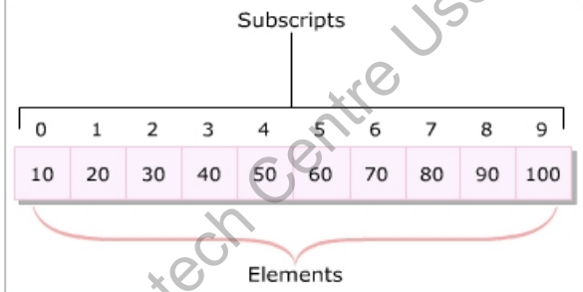
Introduction to Arrays

Slide 7
DECLARING ARRAYS
Arrays are reference type variables whose creation involves two steps:
Declaration:
An array declaration specifies the type of data that it can hold and an identifier.
This identifier is basically an array name and is used with a subscript to retrieve or set the data value at that location.
Memory allocation:
Declaring an array does not allocate memory to the array.

Slide 8
Initializing Arrays
An array can be:
Created using the new keyword and then initialized. \
Initialized at the time of declaration itself, in which case the new keyword is not used.
Creating and initializing an array with the new keyword involves specifying the size of an array.
The number of elements stored in an array depends upon the specified size.
The new keyword allocates memory to the array and values can then be assigned to the array.

Slide 9
Using the foreach Loop for Arrays
The foreach loop:
In C# is an extension of the for loop.
Is used to perform specific actions on large data collections and can even be used on arrays.
Reads every element in the specified array.
Allows you to execute a block of code for each element in the array.
Is particularly useful for reference types, such as strings.

Slide 10
TYPES OF ARRAYS
Based on how arrays store elements, arrays can be categorized into following two types:
Single-dimensional Arrays
Multi-dimensional Arrays

Slide 11
Single-dimensional arrays:
Elements of a single-dimensional array stored in a single row in allocated memory.
Declaration/initialization same as standard declaration/initialization of arrays.
Elements indexed from 0 to (n-1), where n is the total number of elements in the array.

Slide 12

Single-dimensional arrays:

Slide 13
multi-dimensional arrays
A multi-dimensional array allows you to store combination of values of a single type in two or more dimensions.
The dimensions of the array are represented as rows and columns similar to the rows and columns of a Microsoft Excel sheet.
It is also called array of arrays.
Following are the two types of multi-dimensional arrays:
Rectangular Array
Jagged Array

Slide 14
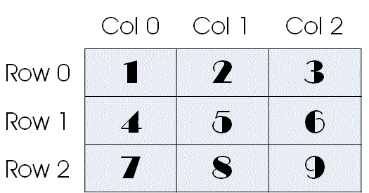
multi-dimensional arrays:

Slide 15
multi-dimensional arrays:
Rectangular Array:
Is a multi-dimensional array where all the specified dimensions have constant values.
Will always have the same number of columns for each row.

Slide 16
multi-dimensional arrays:
Rectangular Array:
There are 3 ways to initialize multidimensional array in C# while declaration.
int[,] arr = new int[3,3]= { { 1, 2, 3 }, { 4, 5, 6 }, { 7, 8, 9 } };
We can omit the array size.
int[,] arr = new int[,]{ { 1, 2, 3 }, { 4, 5, 6 }, { 7, 8, 9 } };
We can omit the new operator also.
int[,] arr = { { 1, 2, 3 }, { 4, 5, 6 }, { 7, 8, 9 } };

Slide 17
multi-dimensional arrays:
Jagged Array:
Is a multidimensional array where one of the specified dimensions can have varying sizes.
Can have unequal number of columns for each row.

Slide 18
INITIALIZING ARRAY WITH USER INPUT IN C#

